Slide 1
Restaurant Recommendations for University of Toronto Students
IBM Data Science Capstone Project
Christopher Cheng

Slide 2
Introduction/Business Problem
Thousands of locals and international students study at the University of Toronto (UofT). If you are new to Downtown Toronto, the area can be quite intimidating!
Downtown Toronto is a busy place with a plethora of restaurants in its vicinity, but how do you know what to eat?
Spending money on food is easy, but how about spending money on food that’s worth it?
Problem: To recommend puzzled UofT students where to eat depending on the type of cuisine they want

Slide 3
Data Required and Acquisition
Geo-coordinates of the University of Toronto
Use the Geocoder API and pass its address found on the UofT website
Top venues near the University of Toronto campus. Will need the restaurant’s name, location, cuisine-type, and number of likes
Can be obtained using Foursquare through an API
Use search query “food” to filter recreational venues

Slide 4
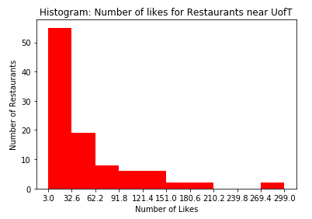

Data Cleaning and assumptions
With the returned JSON file, slice the columns that are relevant and transform it into a data frame
Classify restaurants dependent on their number of likes
Transform all categories and popularity level to dummy variables for modelling
Assumption: The quality of a restaurant will be determined by its number of likes.

Slide 5
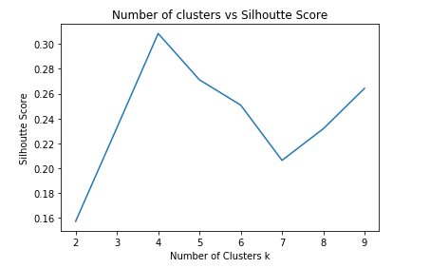
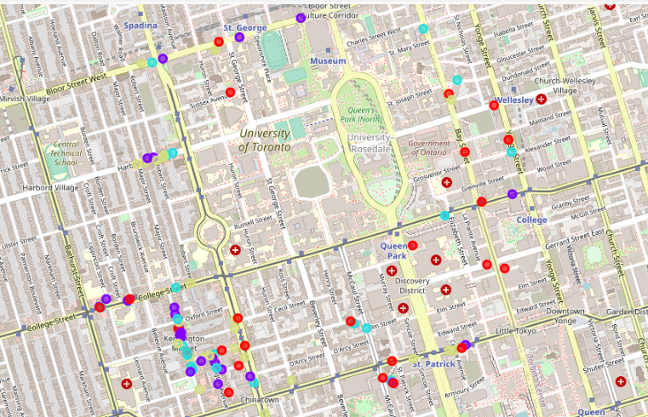
Determine optimal number of clusters
Use the silhouette score to compare the optimal number of clusters to use in the model
We can see that there’s an elbow point at k = 4
Plot the algorithm response labels on Folium

Slide 6
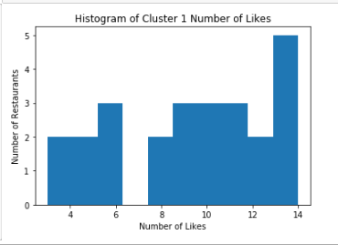
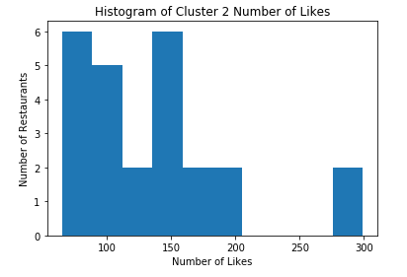
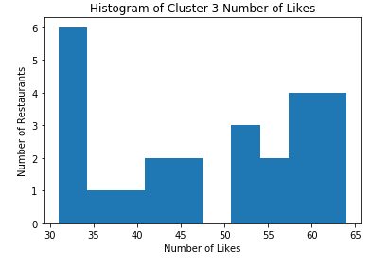
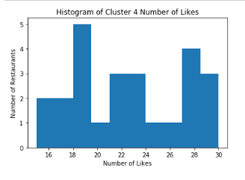
Results
From the 4 clusters returned:
Cluster 1: Restaurants with the lowest number of likes
Cluster 2: Restaurants with the highest number of likes
Cluster 3: Restaurants with an above average number of likes
Cluster 4: Restaurants with a below average number of likes

Slide 7
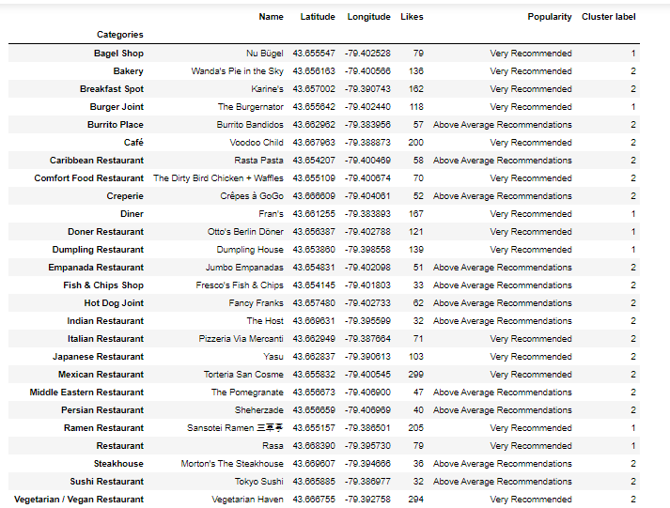
Discussion and Recommendations
From the clusters return from the K-means algorithm, we should only recommend restaurants in cluster 2 and 3
The dataset is grouped by categories and the best restaurant is recommended for each category

Slide 8
Conclusion
This was a fun hypothetical project that allowed me to utilize what I learnt in the course to a real-world scenario
Wads able to utilize critical data-science skills such as Pandas and Scikit-learn!
Would like to use different metrics for evaluating quality
Code: https://github.com/ItsMrTurtle/Coursera_Capstone/blob/master/IBM%20Data%20Science%20Final%20Capstone%20Project.ipynb

